Slide 1
Objective:
By the end of this class period, I will be able to …
identify a property as physical or chemical.
identify a property as intensive or extensive property
differentiate between chemical and physical changes

Slide 2
Agenda
Quiz | 20 minutes
Physical and Chemical Properties | 10 minutes
White board practice | 15 minutes
Physical and Chemical Changes | 15 minutes
Answer Cards | 10 minutes
Independent Practice | 15 minutes
Exit ticket | 10 minutes

Slide 3
Physical Properties
Definition: can be observed without altering the chemical composition of a substance

Slide 4
Physical Properties
Definition: can be observed without altering the chemical composition of a substance
color, texture, malleability, solubility, mass, volume, density
Malleable: capable of being extended or shaped by beating

Slide 5
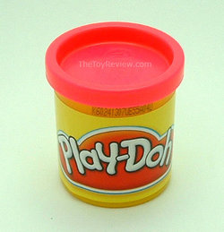
Play Dough: Physical Properties
Color
Texture
Malleability
Solubility
Mass
Density

Slide 6
Chemical Properties
Definition: describes the ability of a substance to combine with or change into one or more new chemical substances.

Slide 7
Chemical Properties
Definition: describes the ability of a substance to combine with or change into one or more new chemical substances.
Toxicity, reactivity, flammability, radioactivity

Slide 8
Play Dough: Chemical Properties
Toxicity
Reactivity
Flammability
Radioactivity

Slide 9
Play Dough: Chemical Properties
Toxicity
Reactivity
Flammability
Radioactivity

Slide 10
Chemical vs. Physical Properties
Ask yourself, “Would I have to change this substance into a new substance in order to view the property?”

Slide 11
Chemical vs. Physical Properties
Ask yourself, “Would I have to change this substance into a new substance in order to view the property?”

Slide 12
Name That Property!!
Series of 6 scenarios
Talk over scenario with your desk partner(s)
Record answer (either physical or chemical property) on your white board

Slide 13
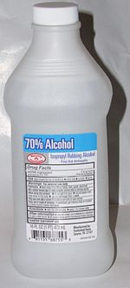
#1
The boiling point of a certain alcohol is 75 degrees Celsius

Slide 14
Physical

Slide 15

#2
Copper forms green copper carbonate when in contact with moist air

Slide 16
Chemical

Slide 17
#3
Table salt dissolves in water

Slide 18
Physical

Slide 19
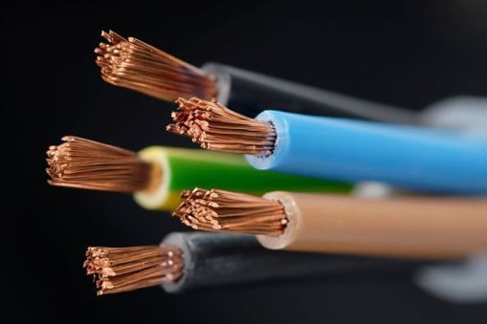
#4
Copper is a good conductor of heat and electricity

Slide 20
Physical

Slide 21
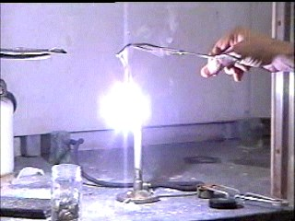
#5
Magnesium burns brightly when ignited

Slide 22
Chemical

Slide 23
#6
Iron is more dense than aluminum

Slide 24
Physical

Slide 25
Physical Properties
Physical properties can be described as being intensive or extensive.

Slide 26
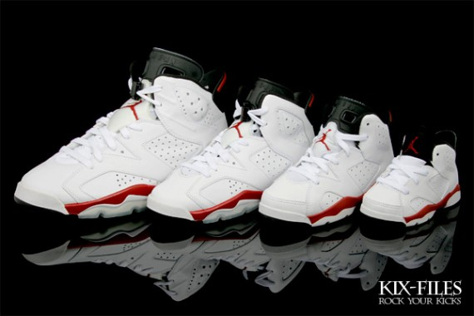
Extensive Properties:
change when the size of a sample of matter changes.
volume, mass, and length

Slide 27
Intensive Properties:
properties that do not change with the sample size
can be useful in identifying a substance

Slide 28
Intensive Properties:
properties that do not change with the sample size
can be useful in identifying a substance
color, density, viscosity, temperature, solubility, and states of matter.

Slide 29
Agenda
Quiz | 20 minutes
Physical and Chemical Properties | 10 minutes
White board practice | 15 minutes
Physical and Chemical Changes | 15 minutes
Answer Cards | 10 minutes
Independent Practice | 15 minutes
Exit ticket | 10 minutes

Slide 30
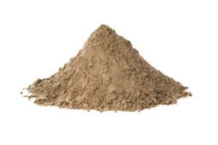
Intensive or extensive??
A pile of sand has a mass of 1,000kg

Slide 31
Extensive

Slide 32
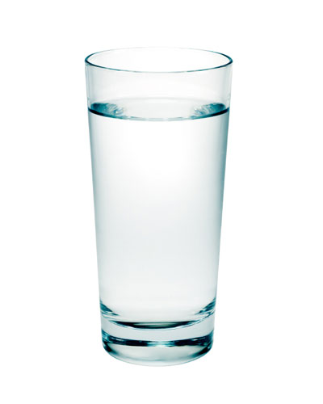
Intensive or extensive??
Water is a liquid at room temperature

Slide 33
Intensive

Slide 34
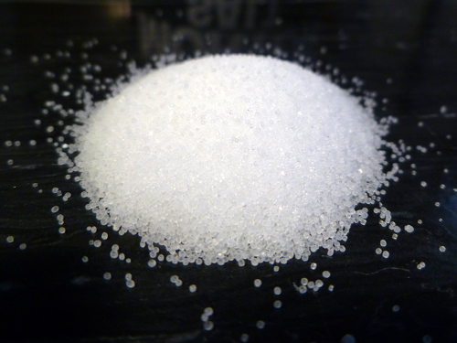
Intensive or Extensive??
Table salt (NaCl) is white

Slide 35
Intensive

Slide 36
Intensive or extensive??
A glass of water has a volume of 1 liter

Slide 37
Extensive

Slide 38
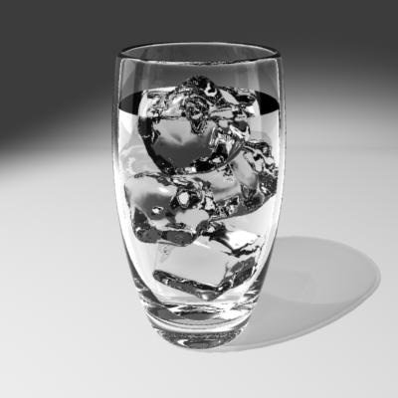
Extensive or Intensive??
An ice cube’s density is 0.96 g/L

Slide 39
Intensive

Slide 40
Agenda
Quiz | 20 minutes
Physical and Chemical Properties | 10 minutes
White board practice | 15 minutes
Physical and Chemical Changes | 15 minutes
Answer Cards | 10 minutes
Independent Practice | 15 minutes
Exit ticket | 10 minutes

Slide 41
Objective:
By the end of this class period, I will be able to …
identify a property as physical or chemical.
identify a property as intensive or extensive property
differentiate between chemical and physical changes

Slide 42
What is matter?
Matter is anything that has mass and takes up space.
All matter can change
2 types of changes
Physical changes
Chemical changes

Slide 43
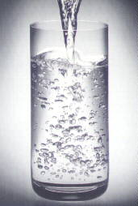
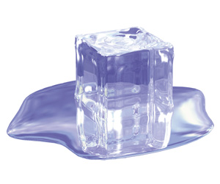
Physical Changes
Definition: when the state or form of matter is changed without changing its chemical composition.
Examples: cutting, freezing, melting, etc.

Slide 44
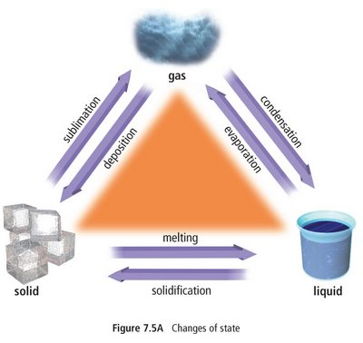
Changes in State: Vocabulary

Slide 45
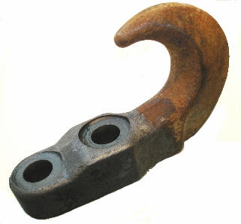
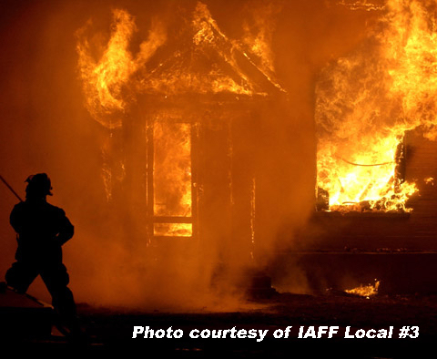
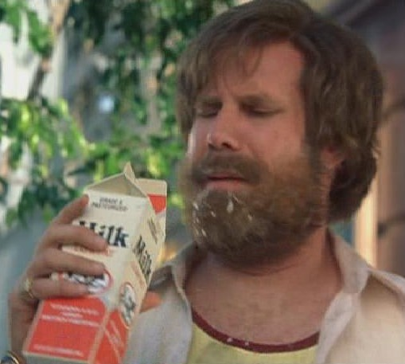
Chemical Change
Definition: takes place on a molecular level and produces a new chemical substance.
A chemical change always involves a chemical reaction.

Slide 46
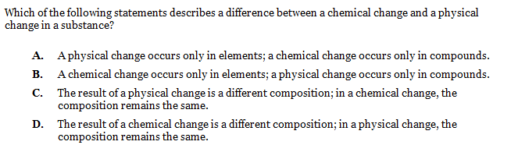
Did you say a test question??

Slide 47
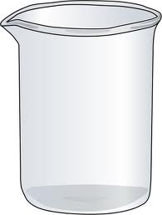
Physical vs. Chemical Changes
Bunsen burner heating water
Electricity run through water

Slide 48
Agenda
Quiz | 20 minutes
Physical and Chemical Properties | 10 minutes
White board practice | 15 minutes
Physical and Chemical Changes | 15 minutes
Answer Cards | 10 minutes
Independent Practice | 15 minutes
Exit ticket | 10 minutes

Slide 49
Name That Change!!
Talk over scenario with your desk partner(s)
Lift up your chemical or physical card
Each correct answer= 1 point
Tie-Breaker at the end!!! Prize!!

Slide 50
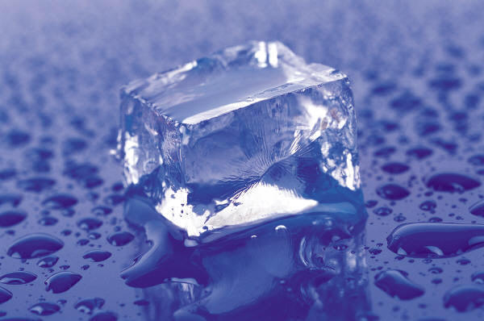
ice melting

Slide 51
P

Slide 52

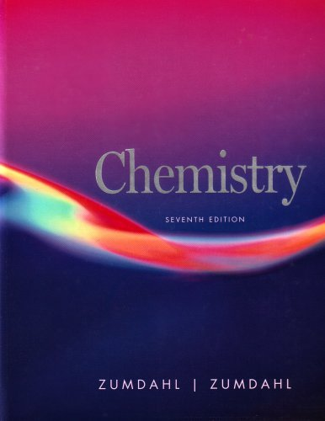
burning a chemistry book

Slide 53
C

Slide 54
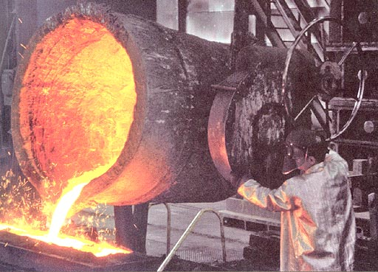
melting iron

Slide 55
P

Slide 56
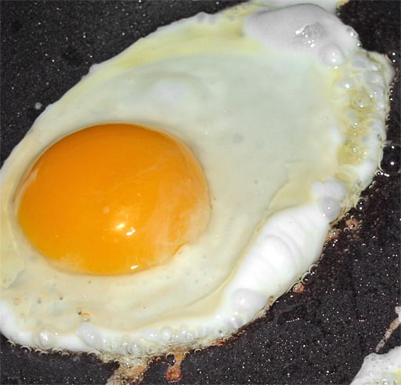
frying an egg

Slide 57
C

Slide 58

fireworks exploding in the sky

Slide 59
C

Slide 60
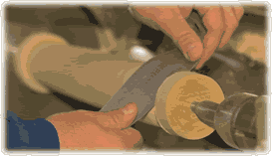
turning wood into a baseball bat

Slide 61
P

Slide 62
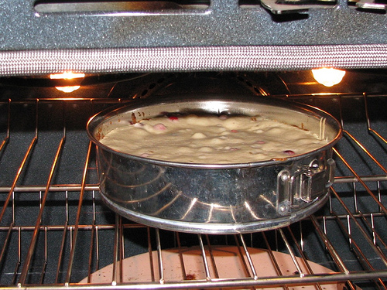
baking a cake

Slide 63
C

Slide 64
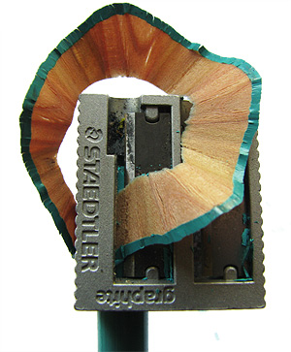
sharpening a pencil

Slide 65
P

Slide 66
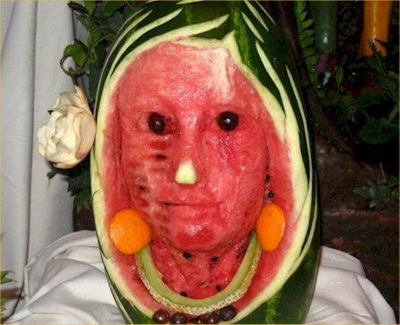
carving a watermelon into a creepy looking face

Slide 67
P

Slide 68
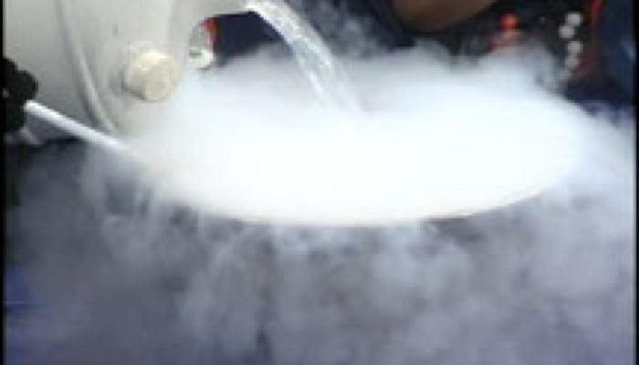
pouring liquid nitrogen into a bowl and watching it vaporize

Slide 69
P

Slide 70
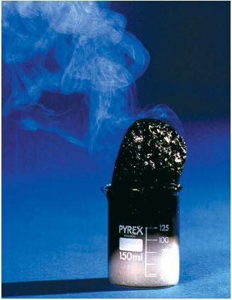
sulfuric acid added to sugar
http://www.youtube.com/watch?v=nqDHwd9rG0s

Slide 71
C

Slide 72
Agenda
Quiz | 20 minutes
Physical and Chemical Properties | 10 minutes
White board practice | 15 minutes
Physical and Chemical Changes | 15 minutes
Answer Cards | 10 minutes
Independent Practice | 15 minutes
Exit ticket | 10 minutes

Slide 73
Where is the Evidence???
Evidence of a chemical change:
color change
Bubbles or gas production
Release of heat, light, odor, or sound.
A solid (precipitate) forms in solution (liquid)
Vocab: ignite, tarnish, evolve

Slide 74
Read the following paragraph to answer questions 1 and 2:
A match is lit and held under a cold piece of metal. The following observations are made:
The match burns. The metal gets warmer. Water condenses on the metal. Black soot (carbon) is deposited on the metal.
1. What is one physical change from the above paragraph? Why is it a physical change?
2. What is one chemical change from the above paragraph? Why is it a chemical change?

Slide 75
Agenda
Quiz | 20 minutes
Physical and Chemical Properties | 10 minutes
White board practice | 15 minutes
Physical and Chemical Changes | 15 minutes
Answer Cards | 10 minutes
Independent Practice | 15 minutes
Exit ticket | 10 minutes

Slide 76
Closure
What is one question that could have a yes or no answer that could always tell you if a change is chemical or physical?
Yes
No
Chemical Change
Physical Change

Slide 77
Is a new substance formed?

